Slide 1
Urk18cs204 k.shravan kumar
Light Monitoring for Plants using Bolt

Slide 2
INTRODUCTION
Light Monitoring for Plants using bolt iot.
we will build a system so that we could monitor the light our plants get and send the data to Bolt Cloud. In fact, this product is commercially available
we will be able to collect the values indicating intensity the of the light and plot them over a line graph.

Slide 3

The Internet of Things (IoT) is nothing new, it has been with us for over a decade, but in this time we have seen the price of devices fall from hundreds of dollars to less than $10! The ESP8266 (and the newer ESP32) have really shaken the world of IoT from being pretty much a novelty industry (we all remember fridges that tweet and ovens that force us to accept an end user licence agreement) into a citizen science revolution where sensors across the world are monitoring climate change, animal migration patterns and much more.

Slide 4
OBJECTIVES:
Our objective is to read the data of the light required of monitoring plant by using sensor.
To control the parameter based on the data by using bolt Iot bolt wifi Module.
Ensure that the minimum amount of light that required for plant from environment .

Slide 5
PROBLEM STATEMENT
We all know that plants require sunlight for their healthy growth. However, at times we may not be able to keep a track of it or maybe we are not sure if our plants are getting enough sunlight.
If the plant get’s the insufficient light ,there will be problem in photosysthesis reaction
we will build a system so that we could monitor the light our plants get and send the data to Bolt Cloud.
we will be able to collect the values indicating intensity the of the light

Slide 6
PROJECT MODULE
INPUT : Hardware Components
Bolt IoT Bolt WiFi Module
Light Dependent Resistor
Resistor 10k ohm
Bolt IoT Bolt Cloud(online service)

Slide 7
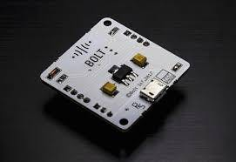
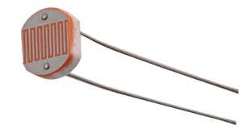
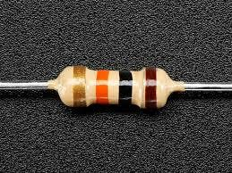
PROJECT MODULES
Bolt wifi module→
ldr
Resistor 10k ohm

Slide 8
PROJECT MODULES
Building the circuit
Make sure you have not powered on your Bolt Module while connecting the circuit. This will ensure that in case we make any mistake, it will not short circuit your device. Switch off the power if it is connected.
Connect one end of the LDR to the A0 (analog) pin of the Bolt device and other ends of the LDR to the 5V pin of the Bolt as shown in the image below.
Connect the 10K ohm resistor between the GND and A0 pin of the Bolt so that LDR and the resistor form a series connection. To see the image for this, click on the > arrow on the image below.

Slide 9
IMPLEMENTATION DETAILS
This project is based on the principle that whenever the light falling on the sensor changes, the resistance of sensor changes which is then converted into a change in voltage. The ADC pin on Bolt WiFi Module converted this analog voltage level into digital values which are shown on the graphs.
We connect the LDR between 5v pin and the analog input pin (A0), so that when light intensity increases, the resistance of LDR decreases so the voltage across the LDR decreases and as a result, the voltage on the analog input pin increases.
This means that as the light intensity increases, the voltage on the analog input pin also increases. The Bolt then converts that the voltage a 10 bit (10 places in binary number system) digital value that varies from 0-1024 (0 to 2 raised to 10).
Image in pg.10 showes briefly….

Slide 10
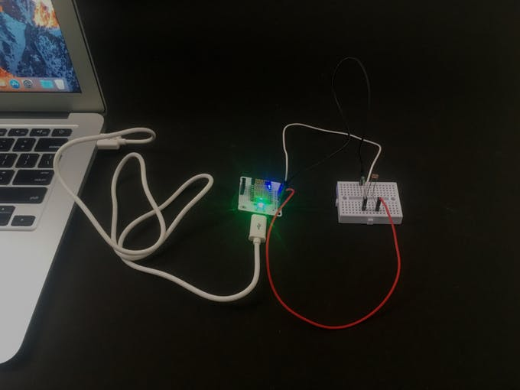
IMPLEMENTATION DETAILS

Slide 11
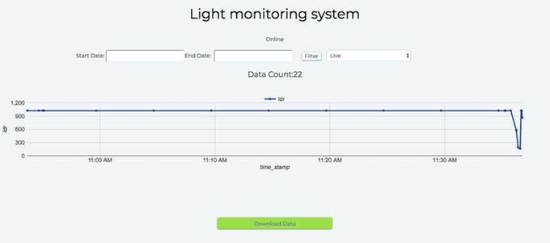
OUTPUT SCREENSHOT:

Slide 12
CONCLUSION:
Bolt cloud ,this tool generated the data from the monitored plant
By collecting the values indicating intensity by the bolt cloud that plot over a line graph
The owner of the plant can know the weather the sunlight is sufficient for his the gardening plants .

Slide 13
THANK YOU

